Slide 1

Guide By :- Abhishek Wavhal
Topic Name :-
Exploratory Data Analysis Hotel Booking
Presented By:-
Payal Pawar
Shweta Auti
Atharav Tarate

Slide 2
Project Summary
This Project was given to us by the team with an intention to understand the Business done by Hotel Group.
This Dataset had two hotels City Hotel and Resort Hotel.
The data provided was for 3 years 2015 , 2016 and 2017.
We also have the revenue and booking details with number of days of stay and booking cancellation , total number of guests including children.
It also specifies guests wait period for booking , repetation of guests , their food choices among others.
The data also gives us an analysation of countries from which bookings have been done.
We also a agent and other channels who also help in business by booking rooms for guests on the resort and city hotel behalf.
The data is divided between city hotel and resort hotel.
We will also take help of charts for better analysis.

Slide 3
Problem Statement
This data set contains booking information for a city hotel and a resort hotel, and includes information such as when the booking was made,the number of adults, children, and/or babies, and the number of available parking spaces, which agent made the booking, among other things.
The objective of this project is Explore and analyze the data to discover important factors that govern the bookings.
Analyse and visualize the data on bookings of City Hotel and Resort Hotel to gain insights on the different factors that affect the booking and ADR.

Slide 4
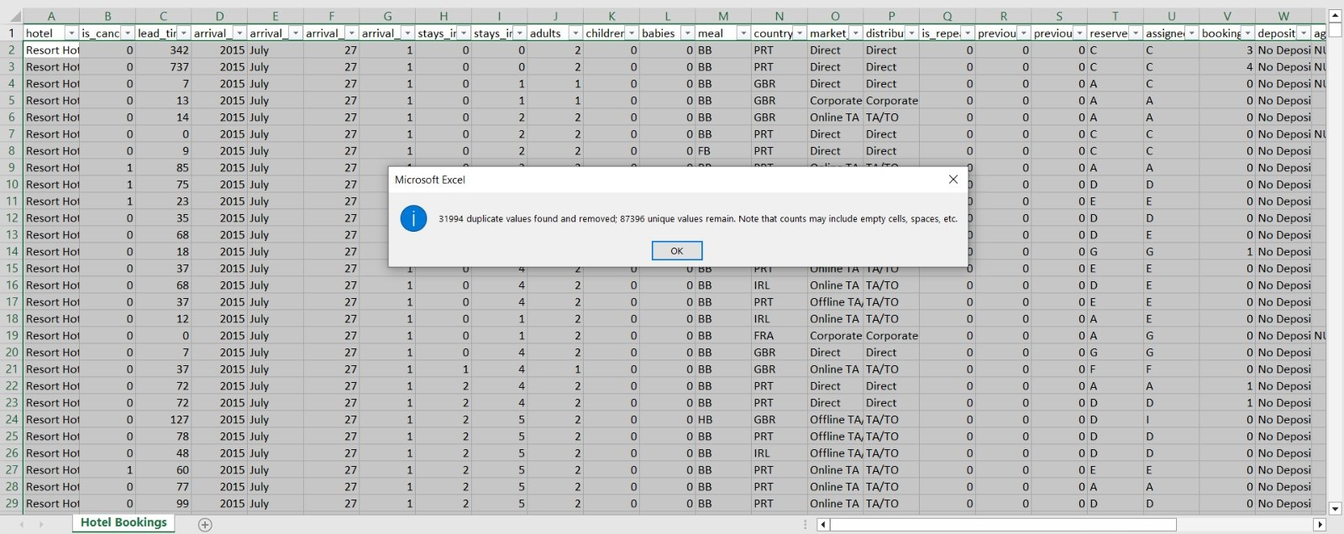
What did you Know About Dataset ?
The given dataset is of Hotel Booking and we have to analyze and explore this dataset to discover important factors which affects the Hotel Booking. This dataset has 119390 rows and 32 columns.
The duplicate value count is 31994 rows.
There are 4 columns in dataset which is having missing values and those columns are company, agent, country and children.
There are separate columns called adults, children and babies that show the total number of people who are coming to visit, so instead of different columns will add these three in one called total_num_people

Slide 5
Description of the Variables:-
hotel - Type of hotel(Resort or City).
is_canceld - If there was booking cancel(0) or not(1).
lead time - The number of days between time books their room to arrive hotel.
arrival_date_year - Year of arrival date.
arrival_date_month - Month of arrival date.
arrival_date_week_number - Week no. of year for arrival date.
stays_in_weekend_nights - No. of weekend nights(Saturday or sunday) spend by guest at hotel.
Stays_in_week_nights -No. of weeknight( Mon to Fri) spend by guest at hotel.
adults - No. of adults among guest.
children - No. of children among guest.
babies - No. of babies among guest.
meal - Type of meal booked by guest.
country - Country of guest.market_segment - grouping into categories based on their booking patterns and travel habits.
distribution_channel - Name of booking distribution channel.
is_repeated_guest - If the booking was from repeated by guest(1) or not(0).
previous_cancelletions - No. of previous booking that were cancelled by the customer prior to the customer booking.
previous_booking_not_canceled - No. of previous booking that were not cancelled by the customer prior to the customer booking.
reserved_room_type - Code of room type reserved.
assigned_room_type - code of room type reserved.
booking_changes - No. of changes made to the booking.
deposit_type - Type of the deposit made by the guest.

Slide 6
agent - Id of the agent who made the booking.
company - Id of the company that made the booking.
days_in_waiting_list - No. of days the booking on the waiting list.
customer_type - Type of customer, assuming one of four categories.
adr - (Average Daily Rate) dividing the sum of lodgging transaction by the total number of staying night.
required_car_parking_spaces - No. of car parking spaces required by the customer.
total_of_special_request - No. of special request made by the customer.
reservation_request - Reservation status
reservation_request_date - Date of last reservation status updated.

Slide 7
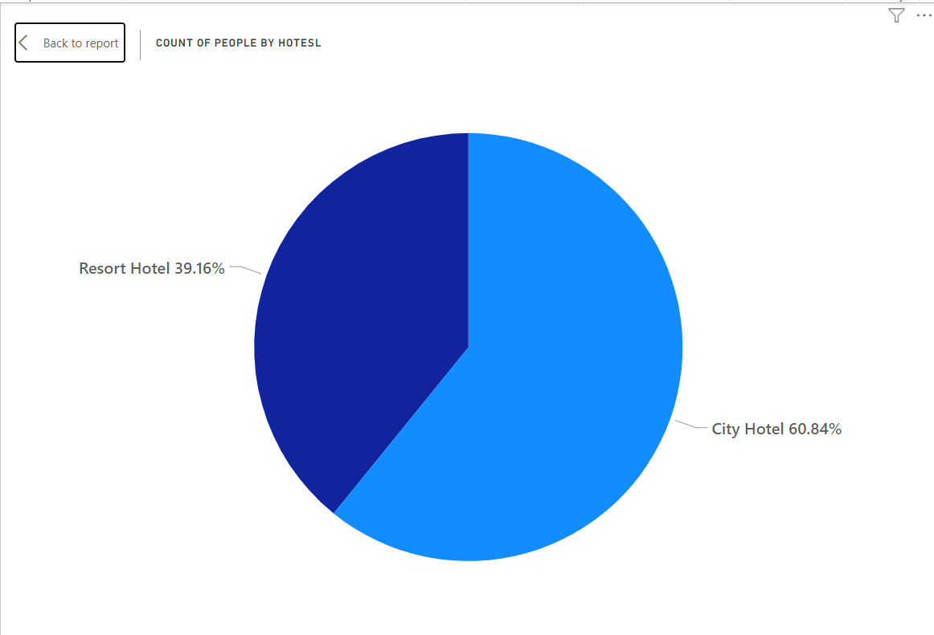
1.Number of peoples book resort hotel and city hotel ?
I have made a pie chart because there are not many categories in these questions.
The majority of people, accounting for 60.84%, prefer staying in city hotels, while the remaining 39.16% opt for resort hotels

Slide 8
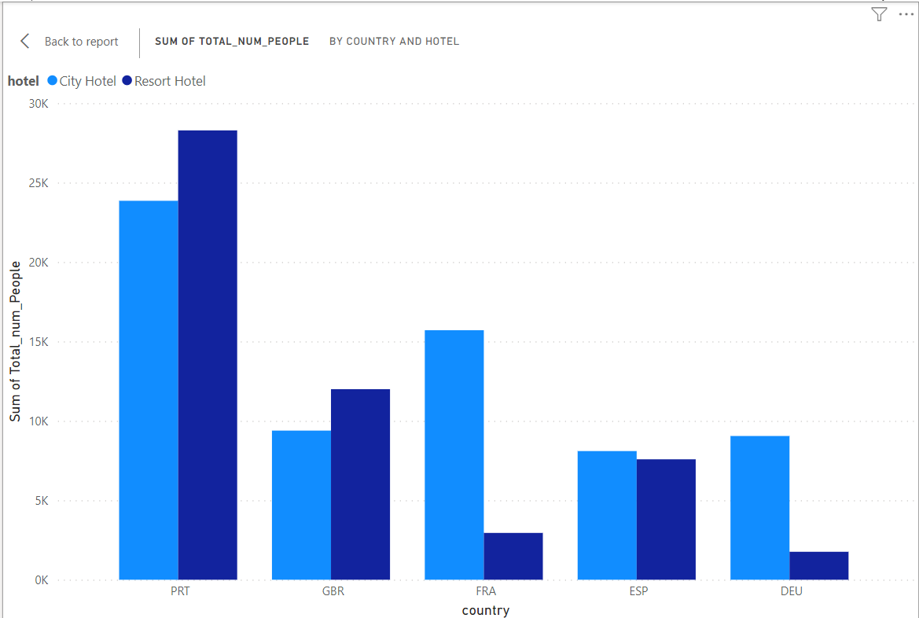
2. from which country we have getting more bookings?
The highest booking is from PRT country
PRT country has made the highest number of booking in resort hotels

Slide 9
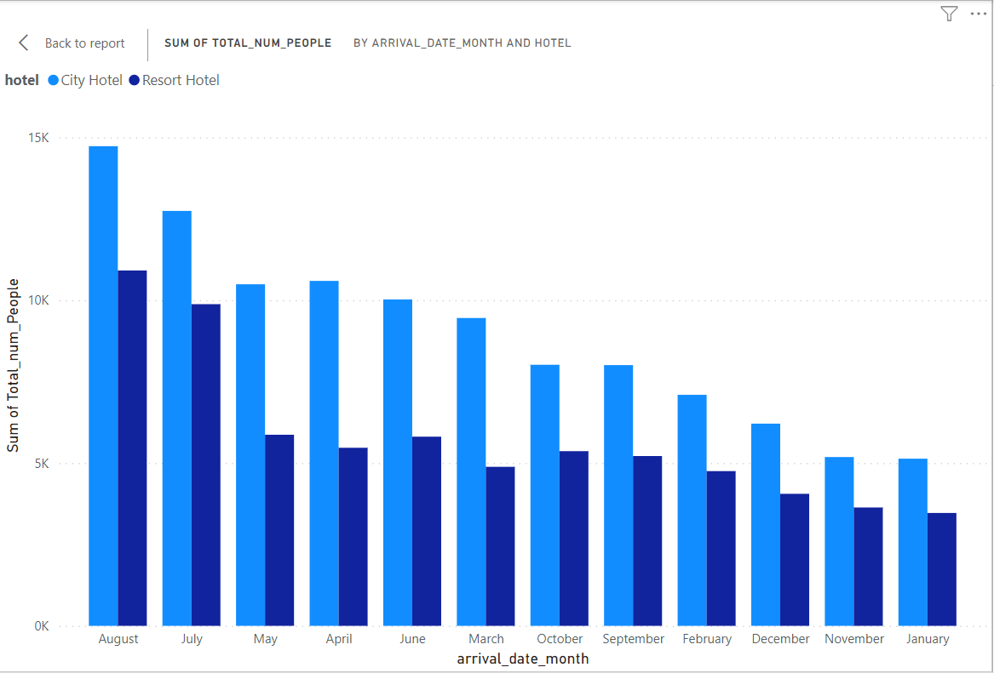
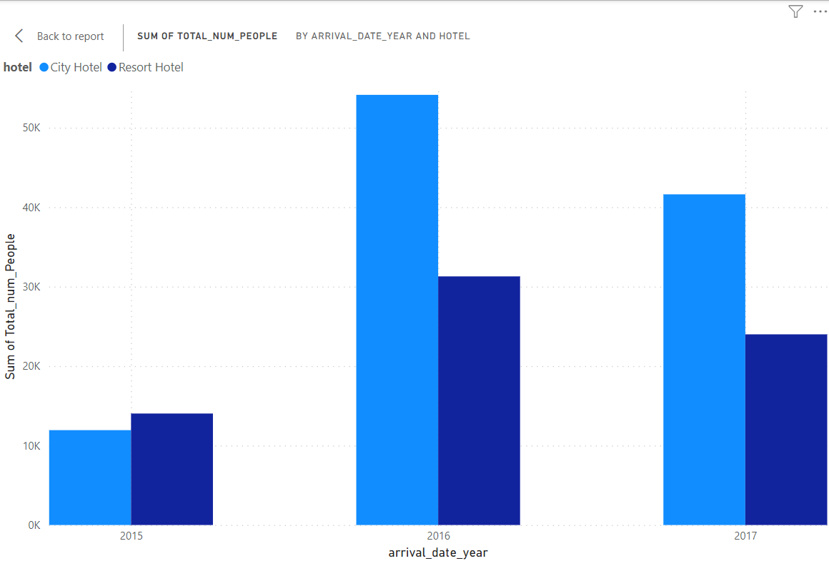
3.in which year or month are more hotels booked ?
Maximum booking have been done in the year 2016 and in the month of August
Lowest booking have been done in the year 2015 and and in the month of January

Slide 10
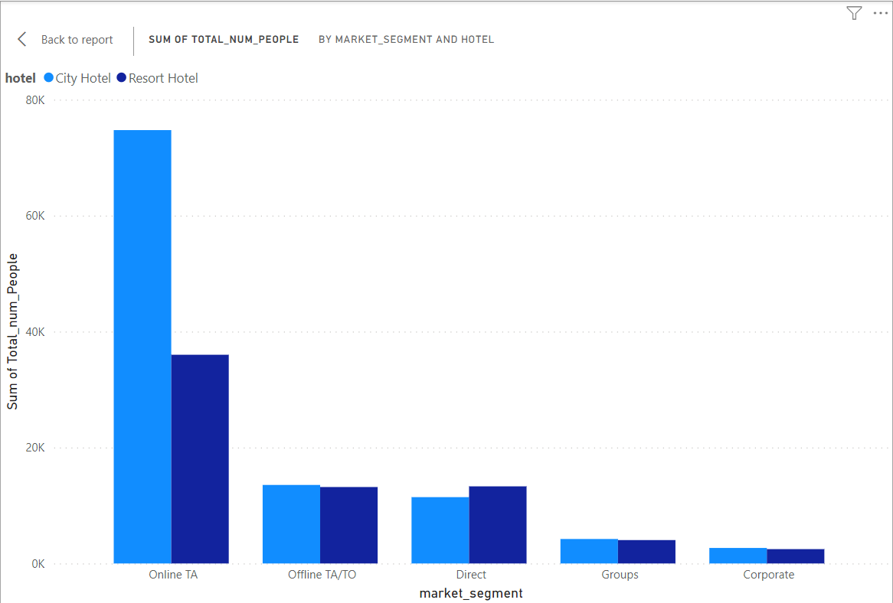
4.from which kind of market we are getting more booking?
Most of Booking in both hotel were done Online TA
Highest booking in City Hotel

Slide 11
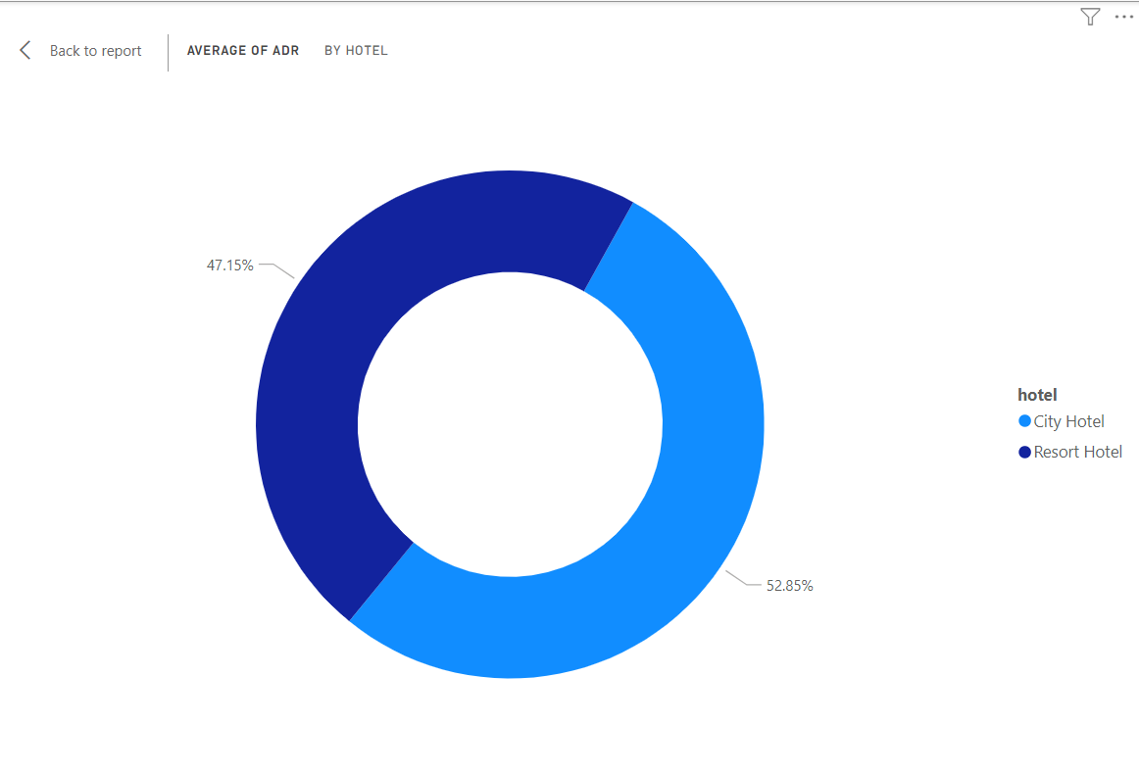
5.which hotel have higher Avg ADR ?
I have made a Dounut chart because there are not many categories in these questions.
City Hotel has the highest rate on the basis od dounut chart

Slide 12
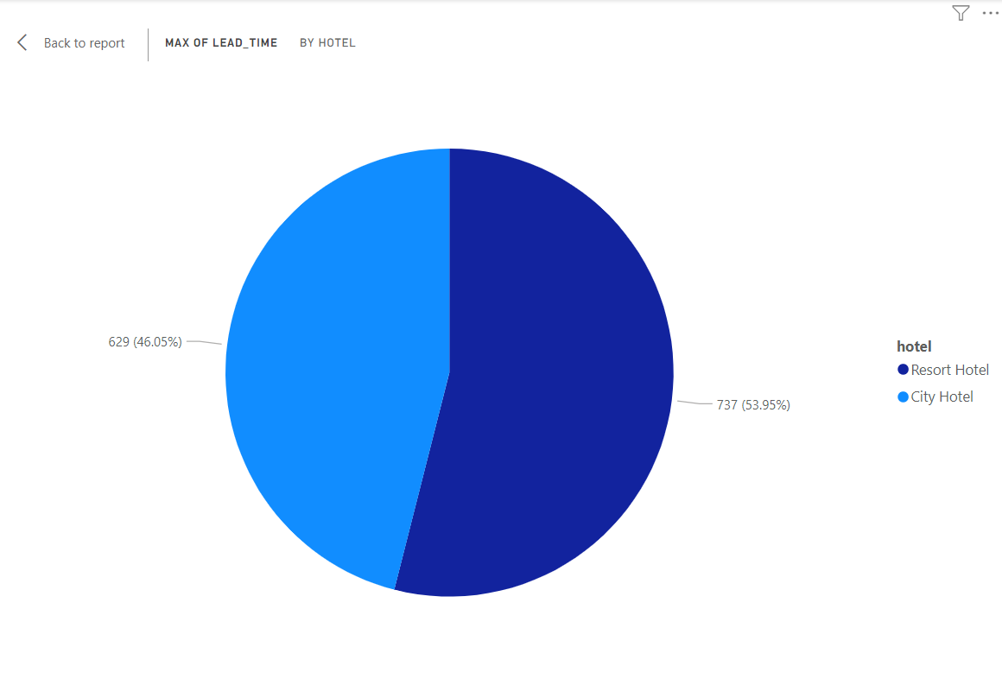
6.which hotel has longer lead_time ?
Resort Hotel have Longer Lead_time based on this pie chart
City hotel owners will have to see what facilities a resort hotel provides due to which the lead time of resort hotel is more then that of city hotels .

Slide 13
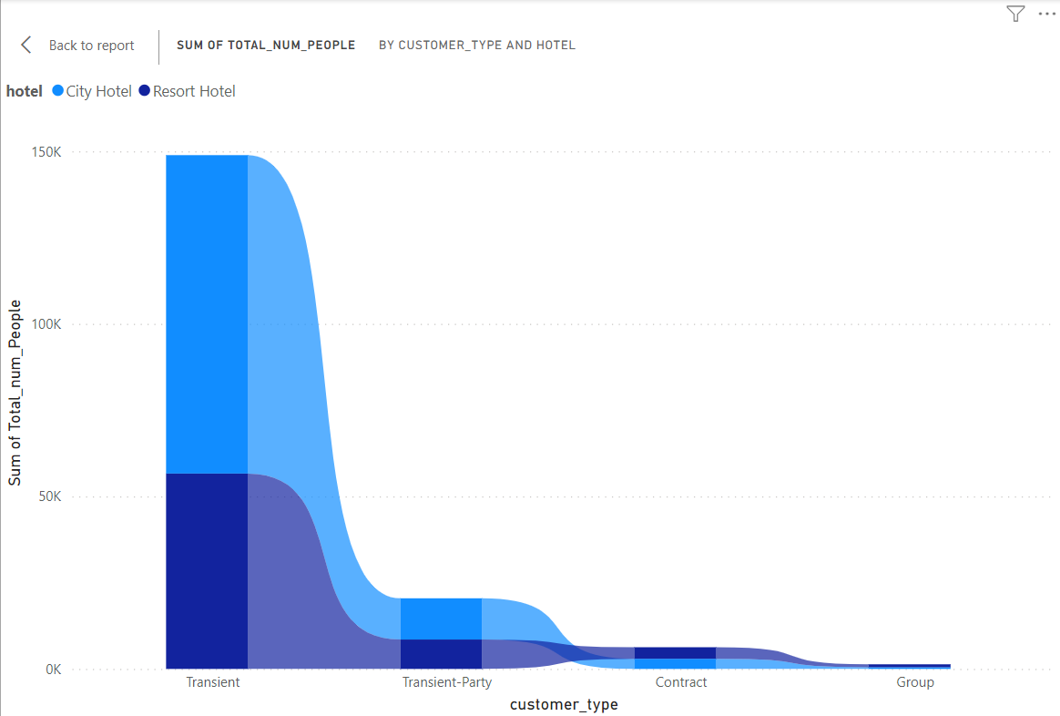
7.which type of customer do you book more ?
It can be seen from the chart that transient type customers book more hotels and group customers book less
What are both the hotels not able to provide that group type customer are booking less?
To solve this problem , what facilities should be provided which will increase group and other types of customer booking

Slide 14
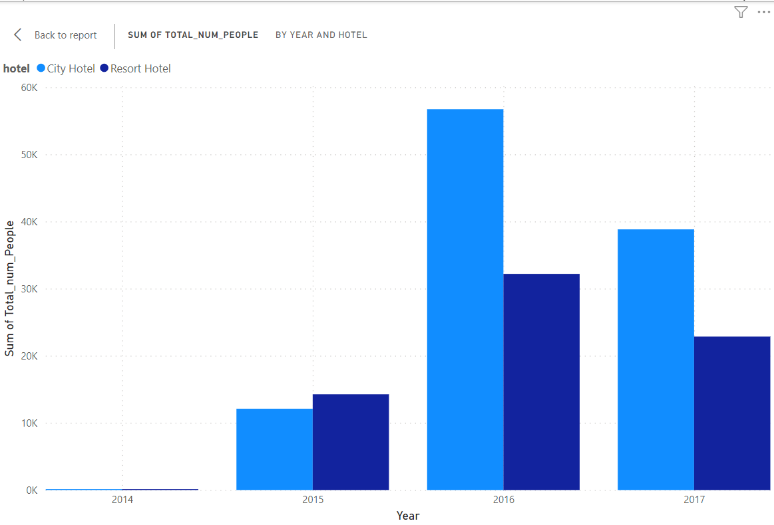
8.Which year has the maximum number of reservations?
From this chart it can be seen that the maximum number of reservations have been made in the year 2016

Slide 15
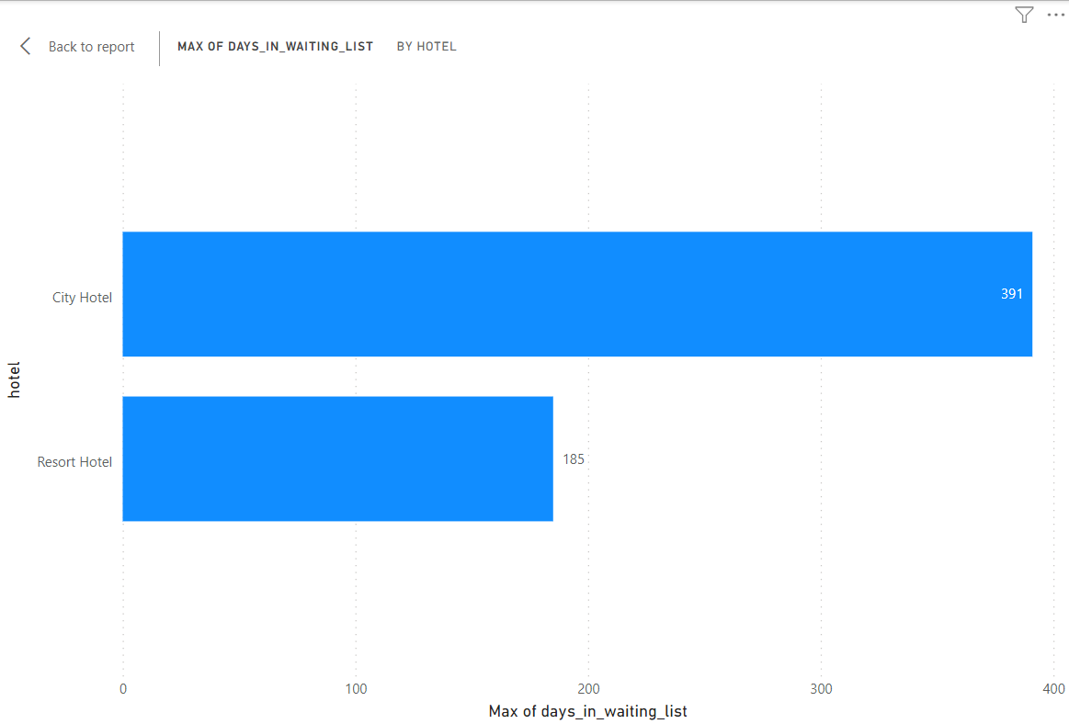
9.which hotel have higher waiting time ?
It can be seen from the chart that there is more waiting time in city hotels
so the city hoteliers will have to work for waiting time ,which will increase their booking rate

Slide 16
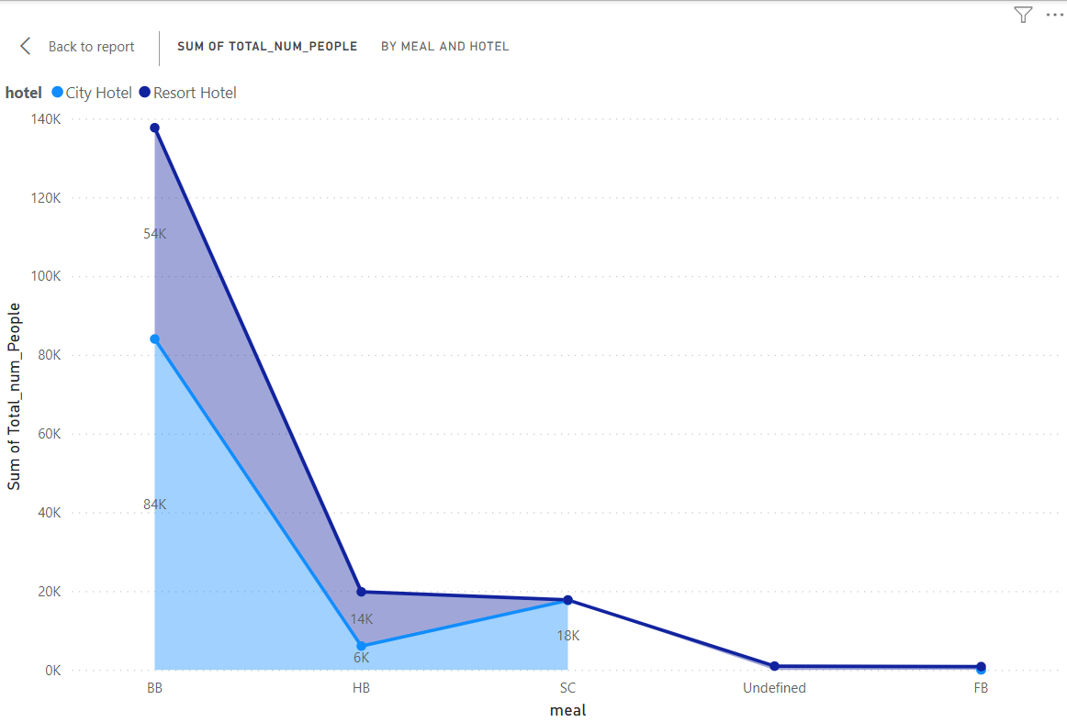
10.What kind of meal most preferred ?
From this chart it can seen that people most preferred bb meal in both hotels.
people are preferred bb meal in Resort hotels more than city hotels.
City hotels should see why their hotels bb meal are being preferred by less people than resort hotels and there should be a change in it.
Both the hotels should be seen why are many people not preferred other type of meal more.

Slide 17
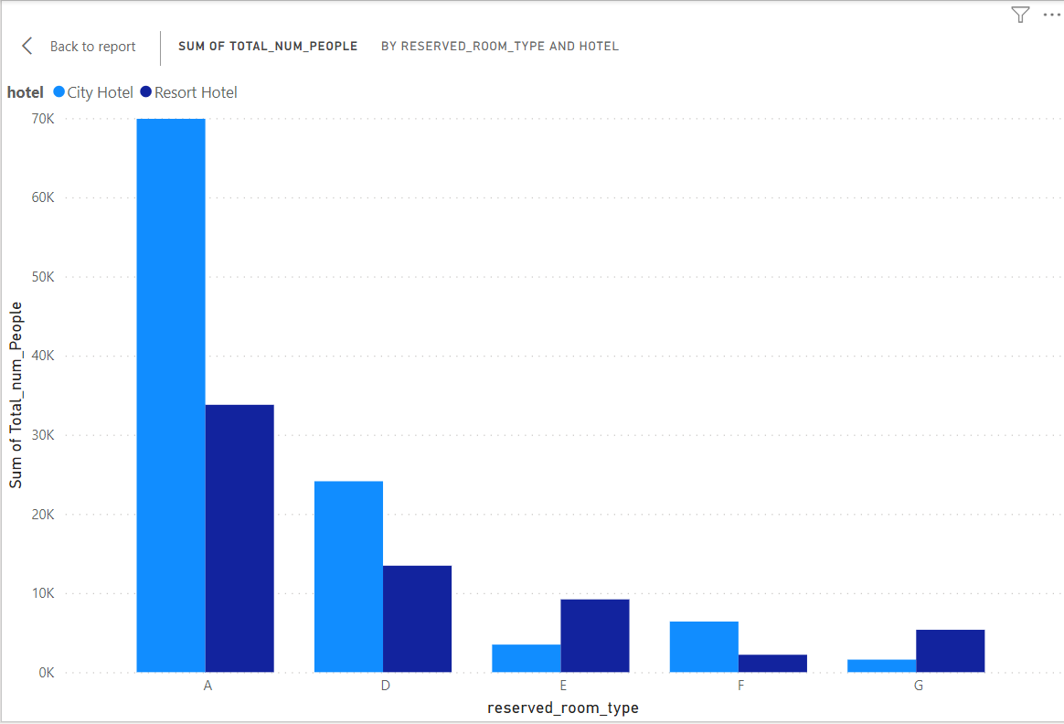
12.In which hotel which type of rooms are booked the most?
In this chart shows that most of the A type rooms are booked in both hotels.
So both hotels should increase the number of A type rooms.
It should be seen what both the hotels do so that other types of rooms are also booked more.

Slide 18
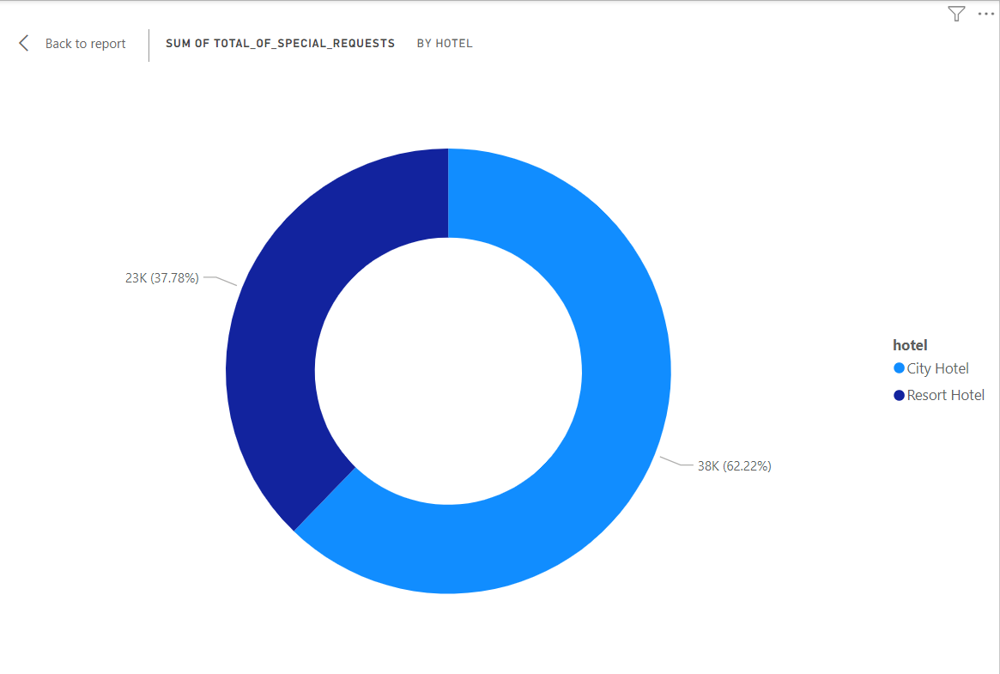
13. Which hotel has received the most special requests?
City hotels have received more special requests then resort hotels.
City hotels have received 62.22% special request and resort hotels received 37.78% special request.

Slide 19
Business Objective
From all the above visualization chart it is clear that the booking rate of resort hotel is less than that of city hotel.
From the entire chart we can say that city hotels are booked more than resort hotels , which means people prefer city hotels more
Resort hotel owners need to improve their businesses a bit.
Resort hotel owners will have to see what facilities are provided by city hotels due to which their booking rate is higher than that of resort hotels.
After doing this complete visualization ,it becomes clear that the city can fulfil the customers needs and provide more facilities to the hoteliers to grow their business
From the above chart , we can see that the request for car parking space near resort hotels is more than that city hotels.
Resort hotel people need car parking spaces if they want to grow their business.
More and more people are preferring city hotels foods compare to resort hotel.
So the resort hotel owners will have to improve the food so that the booking rate increases.
Resort hotel owners need to find the best new offers so that their business increases

Slide 20
Conclusion
In this project, we observed that city hotels are the primary choice of the customers
Bookings through agents are maximum predominant, and guests mainly hail from Portugal, the United Kingdom, France, and Spain.
A and D room type are most preferred room with BB-type food.
As bookings and guest arrivals increase, the Average Daily Rate (ADR) also rises, indicating a positive correlation between ADR and the number of guests.
This suggests that ADR is proportional to the number of people, highlighting the financial growth potential as occupancy rates increase

Slide 21
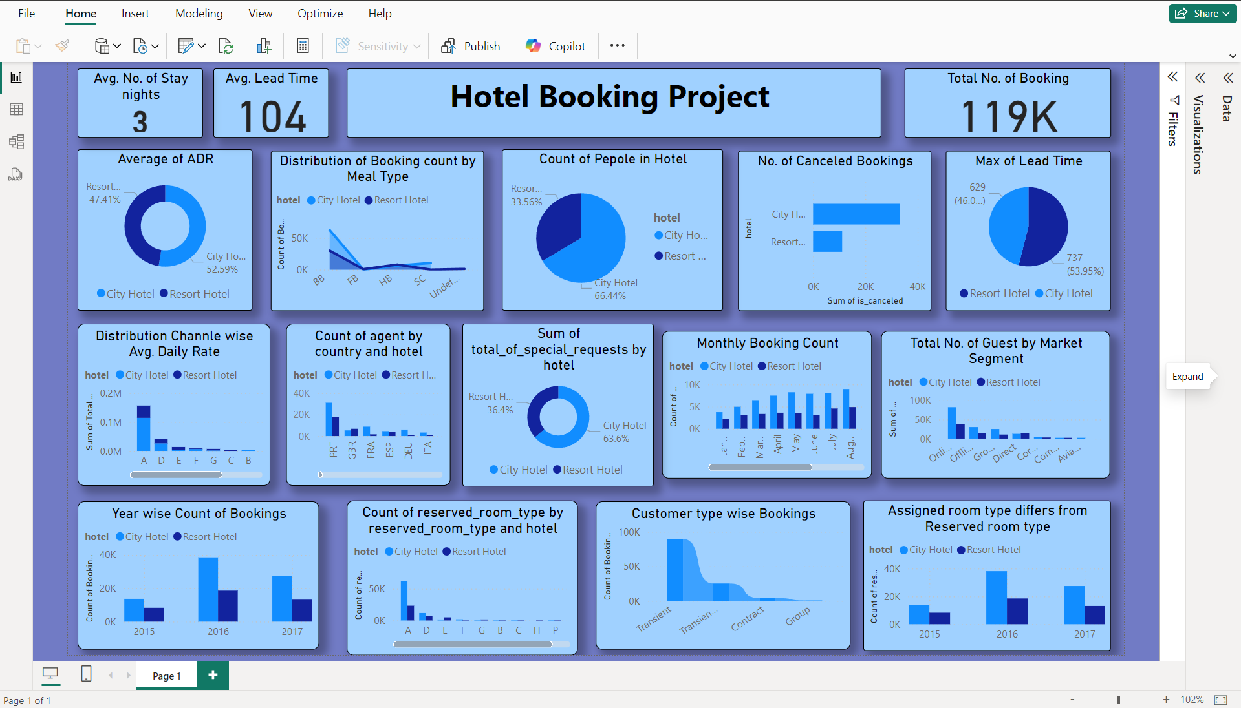

Slide 22


